Slide 1
MGT 388 Finance and Law for Engineers
Management Accounting
Costing

Slide 2
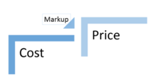
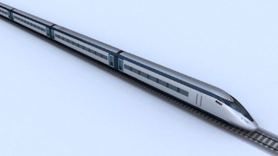

Definition and Purpose of costing
CIMA 2005
“Gathering of cost information and its attachment to cost objects…”
DECISION MAKING
Appropriate costing of a product or service
necessary to assess price and profit.
Tendering for a project needs accurate estimates of future relevant costs.
Short term decisions – if not operating at full capacity should
you accept an order at a discounted price?
FINANCIAL ACCOUNTS
Inventory valuation for annual reports.

Slide 3
Product Costing/ Absorption Costing
Absorption costing is the method use to obtain the full cost of a product or service.
This cost is then used for the valuation of inventory in the Annual Report and can be used as a basis for determining the price for the product.

Slide 4


Product V Period Cost
Manufacturing costs are product costs
Office costs are period costs

Slide 5
Product V Period costs
Product Cost
Inventory
Cost of sales
Period cost
Administration
Expense
Distribution
Costs

Slide 6
Product Cost
The product cost is:
£
Direct Materials X
Direct Labour X
Other Direct Expenses X
Prime Cost X
Indirect production costs/ overheads X
Product cost X
Direct costs are costs that can be related to a product or service or project in an economically feasible way
Indirect production costs are costs that relate to the product but can’t be traced in an economically feasible way

Slide 7

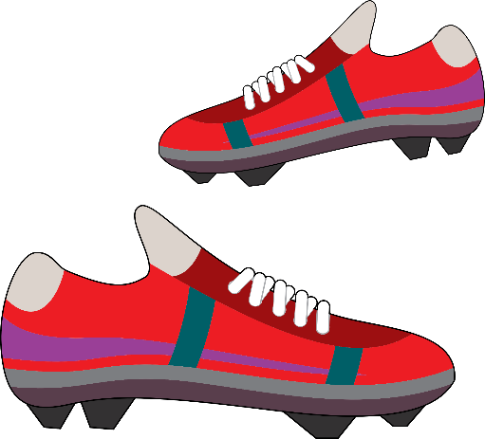
Question
Volley plc manufactures football boots and incurs the following monthly costs: £
Leather to make the boot 5,000
Studs, laces etc used in the boot 1,000
Salary of accounting team 6,000
Salaries of staff working in the factory 8,000
Total cost 20,000
During one month 500 pairs of football boots are produced.
Calculate the product cost?

Slide 8
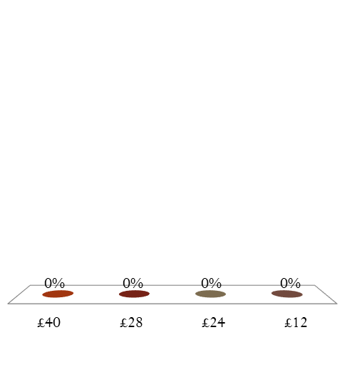
What is the product cost of a pair of football boots
£40
£28
£24
£12

Slide 9
Calculating the Product Cost Absorption Costing
In arriving at a product cost , calculating the total direct cost is straightforward. However it is not always easy to calculate the amount of indirect costs to include.
Absorption costing provides a process to follow:
Trace all direct and indirect costs to cost centres
Allocate and apportion production overhead costs
Absorb the costs into products

Slide 10

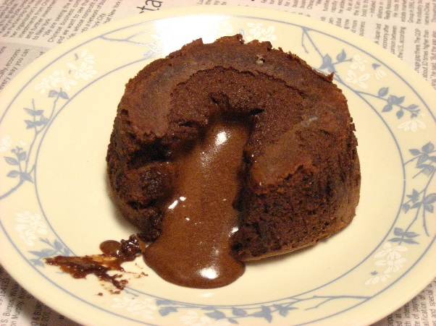
Example Sponge and Chocolate
A factory has 3 departments with each treated as a separate cost centre. These are:
Production Department 1 (Producing sponge celebration cakes)
Production Department 2 (Producing chocolate celebration cakes)
Service Department (maintaining equipment in both production departments)
The Prime cost for Sponge cakes is £35.
10,000 Sponge cakes are produced.
The Prime cost for Chocolate cakes is £42. 8,000 Chocolate cakes are produced.

Slide 11
Example Sponge and Chocolate
Production Overheads Are: £
Indirect ingredients 28,000
Building costs 30,000
58,000
Indirect ingredients while not attributed to particular cakes can be allocated to departments as follows:
Sponge cakes £18,000
Chocolate cakes £10,000

Slide 12
Example Sponge and Chocolate Having been able to allocate indirect ingredients to cost centres, the building costs must now be apportioned to the 3 cost centres. The management accountant will seek to apportion on the most realistic basis
 | Department 1 Sponge | Department 2 Chocolate | Service Department Maintenance | Total
Area (sq mtres) | 16,000 | 20,000 | 4,000 | 40,000
Value of plant £’000 | 500 | 750 | 0 | 1,250

Slide 13
Example Sponge and Chocolate
The most realistic way for building costs of to be apportioned would be area.
The indirect building costs were £30,000
£30,000/40,000sq metres = £0.75 per square metre
 | Department 1 Sponge | Department 2 Chocolate | Service Department Maintenance | Total
Area (sq mtres) | 16,000 | 20,000 | 4,000 | 40,000

Slide 14

Example Sponge and Chocolate
Building costs to Production Centre 1 (Sponge)
16,000 X £0.75 = £12,000
Building costs to Production Centre 2 (Chocolate)
20,000 X £0.75 = £15,000
Building costs to Maintenance Department
4,000 X £0.75 = £3,000
Total building costs £30,000

Slide 15
Example Sponge and Chocolate
The indirect production costs/ overheads have now been allocated and apportioned to cost centres as follows:
Overheads | Department 1 Sponge | Department 2 Chocolate | Maintenance | Total
Indirect ingredients | 18,000 | 10,000 |  | 28,000
Building costs | 12,000 | 15,000 | 3,000 | 30,000
Total | 30,000 | 25,000 | 3,000 | 58,000

Slide 16
Example Sponge and Chocolate
Purpose : Attach all production costs to products.
Departments that do not make any products but service production centres have collected costs. These costs need to be re-apportioned to production centres on a reasonable basis.
The service centre in our example is a maintenance department and a reasonable apportionment basis would be value of plant.

Slide 17
Example Sponge and Chocolate
Maintenance has collected costs of £3,000 these are apportioned as follows:
£3,000/£1,250,000 = £0.0024 per £ of plant
 | Department 1 Sponge | Department 2 Chocolate | Service Department Maintenance | Total
Value of plant £’000 | 500 | 750 | 0 | 1,250

Slide 18

Example Sponge and Chocolate
Production department 1 (Sponge)
500,000 X £0.0024 = £1,200
Production department 2 (Chocolate)
750,000 X £0.0024 = £1,800
£3,000

Slide 19
Example Sponge and Chocolate
The indirect production costs/ overheads have now been allocated and apportioned to Production cost centres as follows:
 | Department 1 Sponge | Department 2 Chocolate
Indirect ingredients | 18,000 | 10,000
Building costs | 12,000 | 15,000
Total indirect costs | 30,000 | 25,000
Maintenance department | 1,200 | 1,800
Total | 31,200 | 26,800

Slide 20
Example Sponge and Chocolate
All that remains to do is to absorb the overheads into the product cost.
The total overhead in Department 1 Sponge is £31,200 and 10,000 sponge cakes are produced.
Therefore each sponge cake has:
£31,200/10,000 = £3.12
Total Product Cost For Sponge: £
Prime cost (all direct costs) 35.00
Indirect production overheads 3.12
Total product cost 38.12

Slide 21

Example Sponge and Chocolate
The total overhead in Department 2 Chocolate is £26,800 and 8,000 chocolate cakes are produced.
Therefore each chocolate cake has:
£26,800/8,000 = £3.35
Total Product Cost For Chocolate: £
Prime cost (all direct costs) 42.00
Indirect production overheads 3.35
Total product cost 45.35

Slide 22
Example Sponge and Chocolate
In the annual report the inventory valuation for sponge cakes will be £38.12 and for chocolate cakes £45.35.
In terms of pricing the company will add an appropriate percentage on for non-production costs and a profit margin
Cost
% for non-production cost
% for profit
Price

Slide 23


Can Absorption Costing be used for pricing?
Business where large part of costs are direct costs?
Business where large part of the costs are manufacturing overheads?
Business with a competitive market?
Business with niche or premium product?

Slide 24
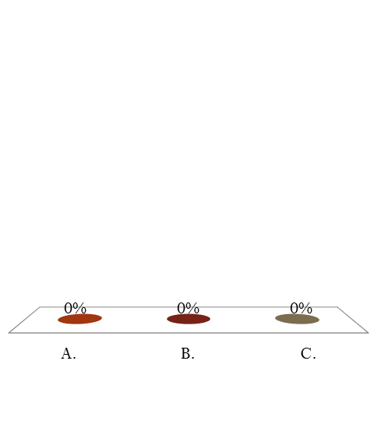
For which business would absorption costing be an inappropriate basis for setting a price.
Contract based business
Fashion
Manufacturing where the main costs are direct costs

Slide 25
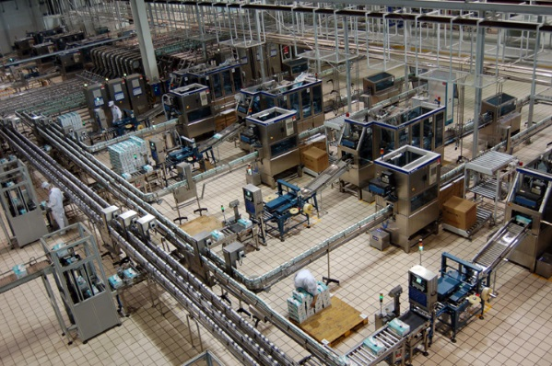
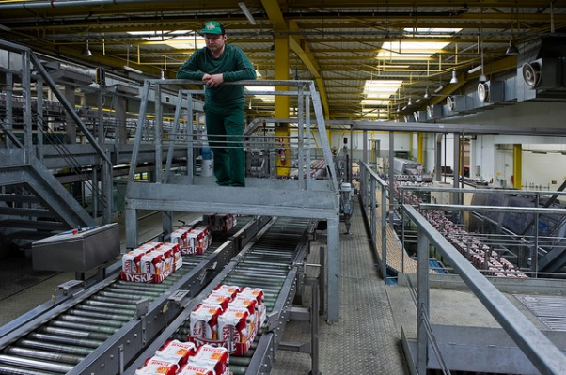
One Product Passing Through Two Production Centres
In the previous example the overhead absorption rate was the number of units produces as each department made one product from beginning to end.
In many industries a product may go through more than one production centre. In this case the overhead absorption rate used may be machine hours or labour hours rather than units produced.

Slide 26


One Product Passing Through Two Production Centres
A company manufactures 1,000 tennis racquets. The tennis racquets pass through one department for the frame and one for the strings.
Frame department – direct costs £30 per racquet
- production overheads £8,000
The frame department is highly mechanized using 2,000 machine hours. (As 1,000 tennis racquets are produced each racquet requires 2 hours of machine time)
String department - direct costs £12 per racquet
- production overheads £5,000
To be allocated according to units of production.

Slide 27
One Product Passing Through Two Production Centres
Production Cost Of Tennis Racquets £
Direct frame costs 30
Direct string costs 12
Prime cost 42
Indirect costs
Frame overheads
£8,000/2,000 machine hours 4 x 2hrs 8
String overheads £5,000/1,000 units produced 5
Total production cost 55

